Slide 1
Lab 2
Data Ingestion using
Beats, Sysmon and MITRE ATT&CK™ configs
Notes:
Allow us to introduce Elastic SIEM — our first official step in building our vision for what a SIEM should be.

Slide 2
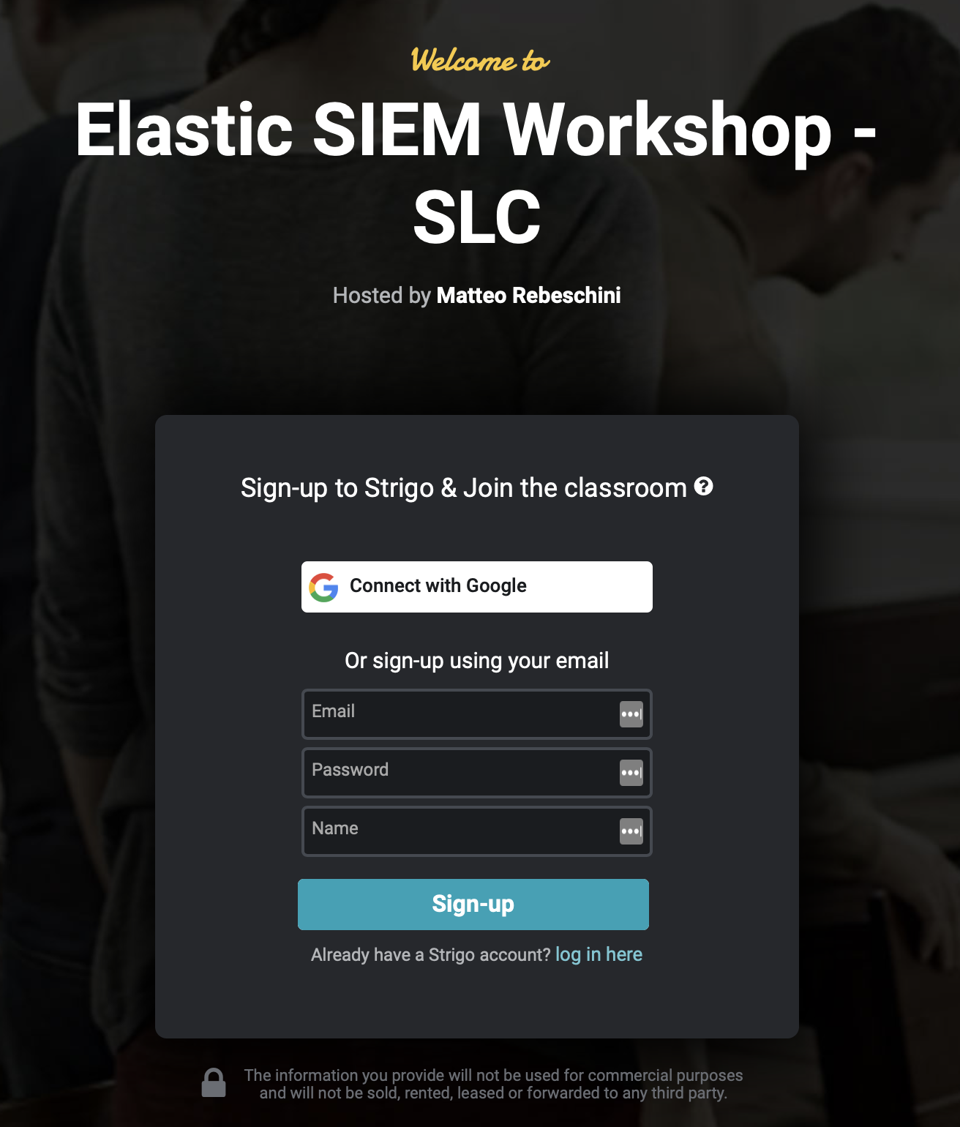
Setup Strigo
Your Training Environment
Class URL:
https://ela.st/bgl-security-lab2
Access Token:
LZPX
Lab environment will stay active until 23/10 @ 6:00PM IST
Notes:
URL
https://app.strigo.io/event/5BW9NXdrTCR6nzvdB
Access Token
DNXR

Slide 3
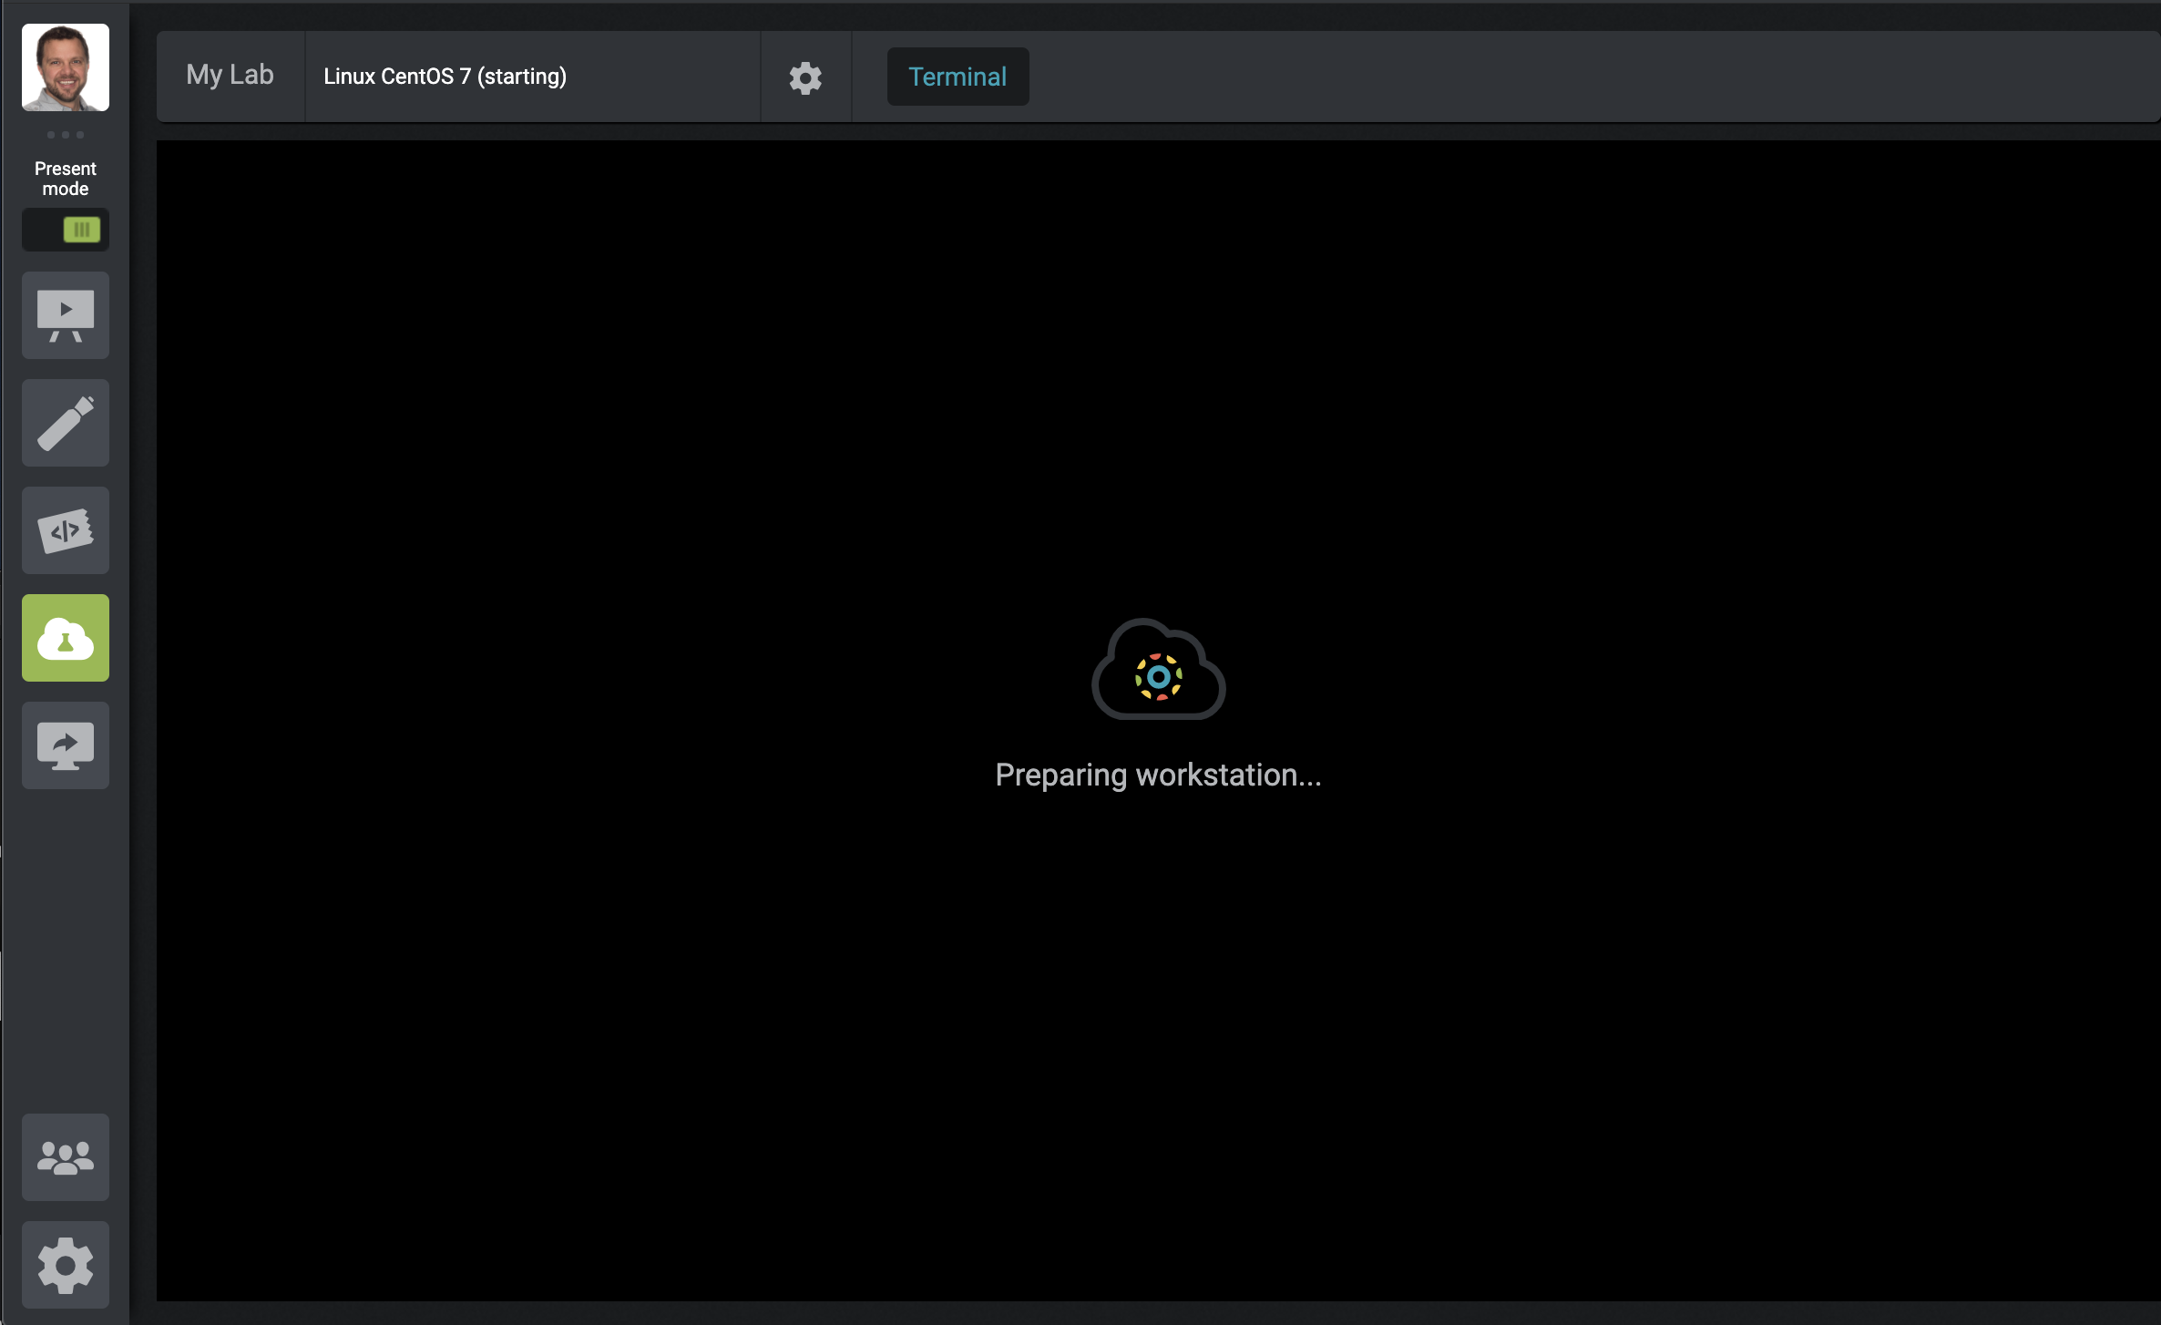
Linux Beats Scripted Install
Access “My Lab” (it will take a few minutes)
1
Select ‘My Lab’

Slide 4
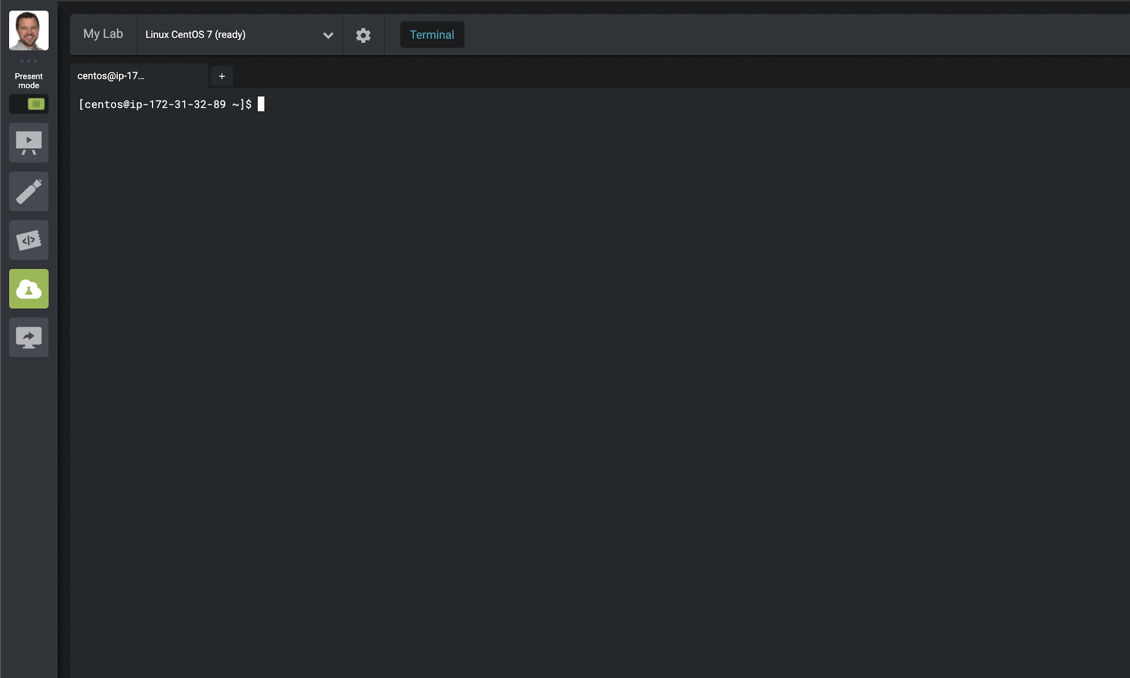
Linux Beats Scripted Install
You will see a CentOS Terminal when Lab Instance is Ready
1
After a few minutes, a CentOS Linux instance should be available under ‘My Lab’

Slide 5
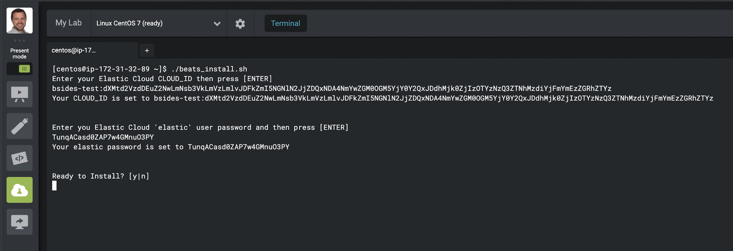
Linux Beats Scripted Install
Installation of MetricBeat, Filebeat, AuditBeat and PacketBeat
1
Type ‘sudo ./beats_install.sh’
2
Copy-n-Paste the CLOUD ID created in Lab 1
3
Copy-n-Paste the elastic user’s password created in Lab 1
Notes:
Questions:
Do any of you automate Linux end points today?
Hands for:
K8’s, ansible, puppet, chef
How you monitor and debug that automation?

Slide 6
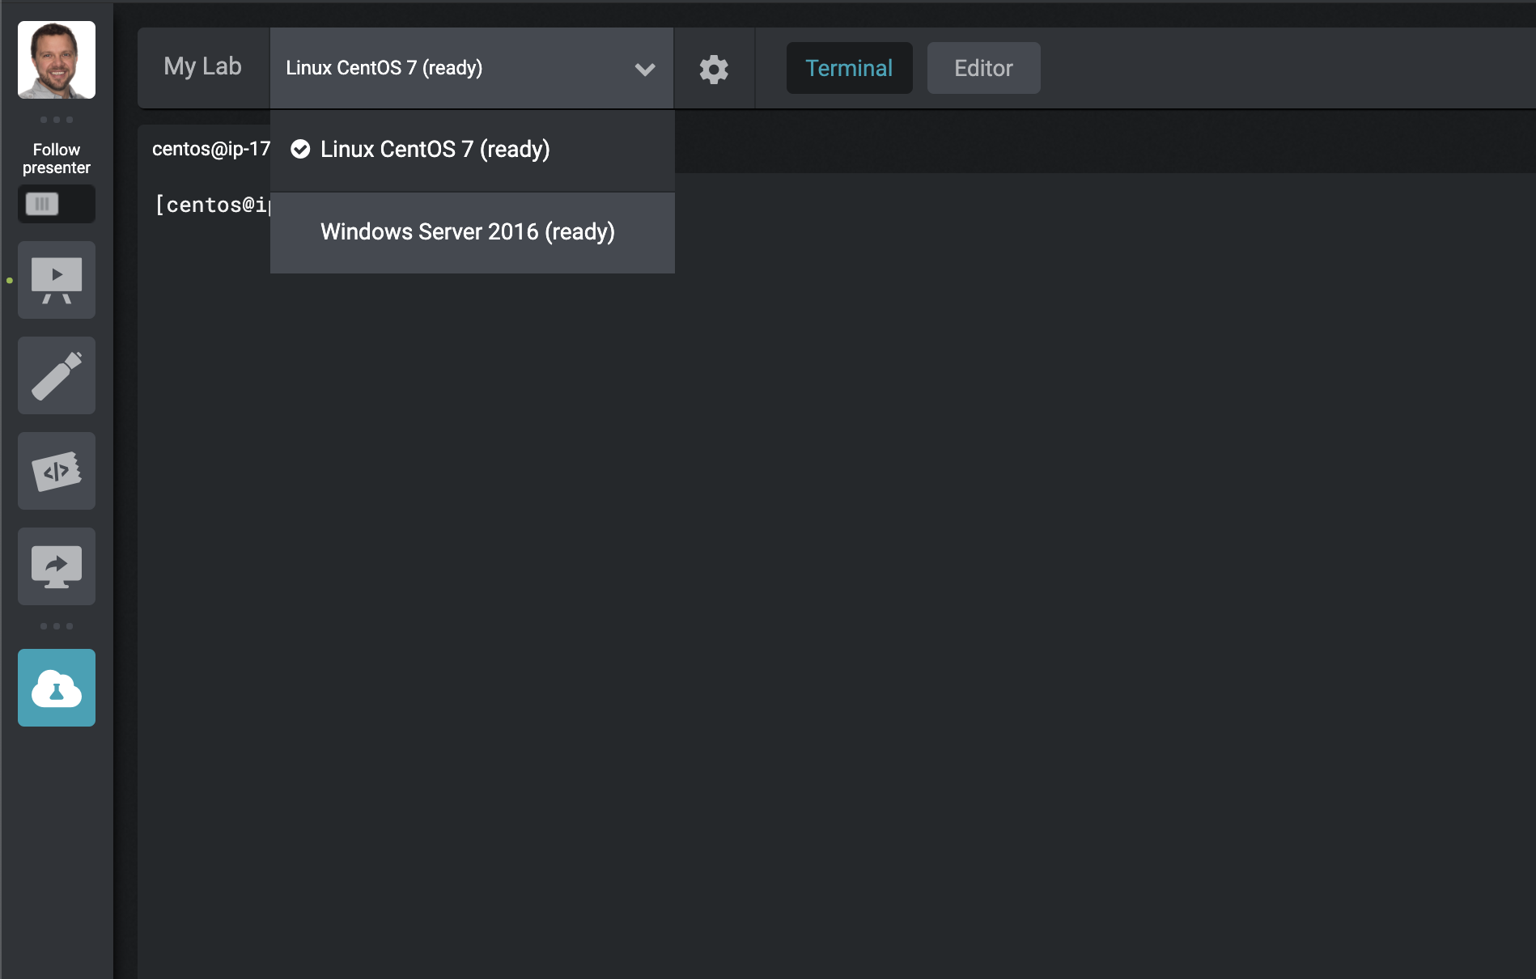
Windows Beats Scripted Install
1
Access your Windows Server 2016 Instance
Select the arrow next to ‘My Lab’
2
Select ‘Windows Host’

Slide 7
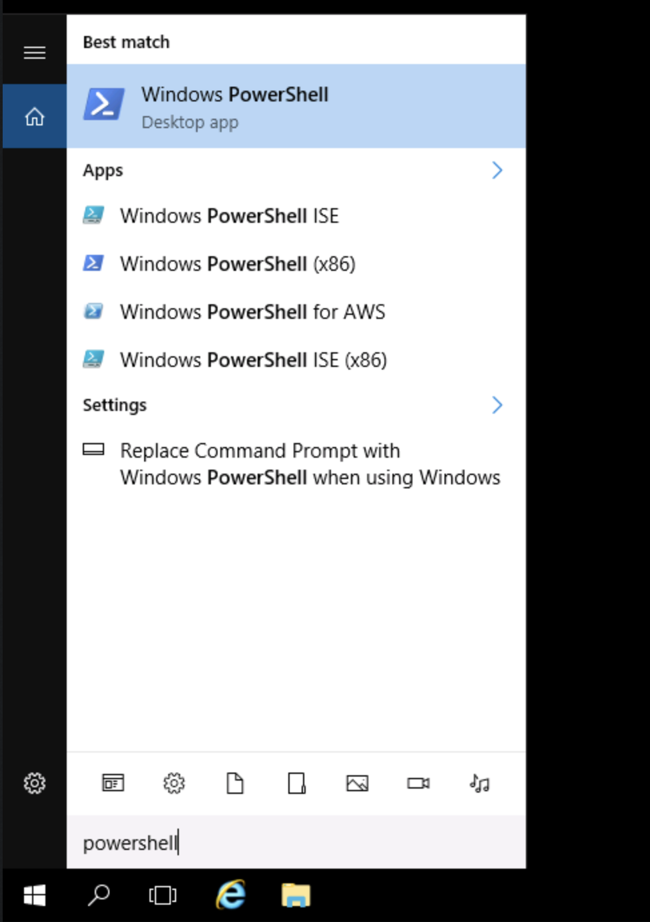
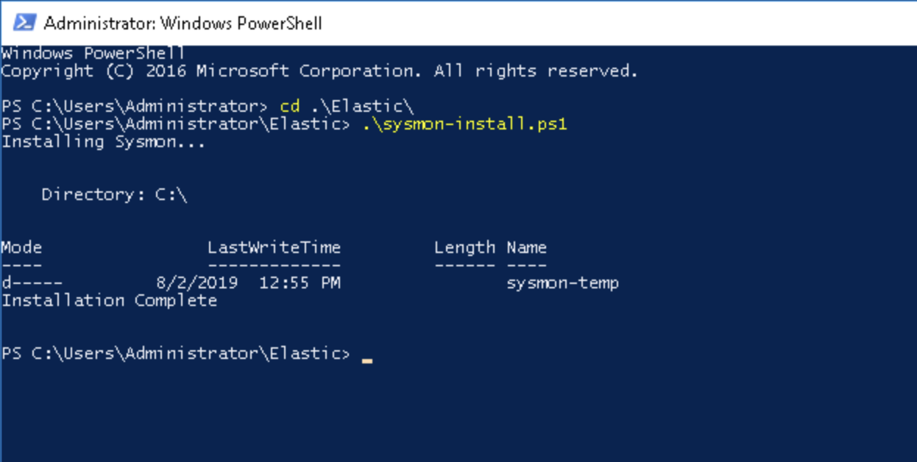
Windows Scripted Install
Install Sysmon with Custom Config Template
1
Type: cd ela <TAB> to autocomplete .\Elastic\>
<RETURN/ENTER>
2
Type: sys <TAB> to autocomplete ‘.\sysmon-install.ps1’
<RETURN/ENTER>

Slide 8
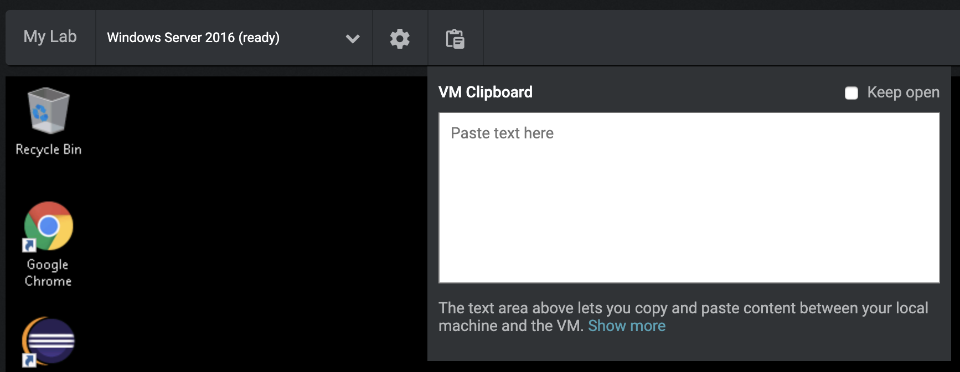
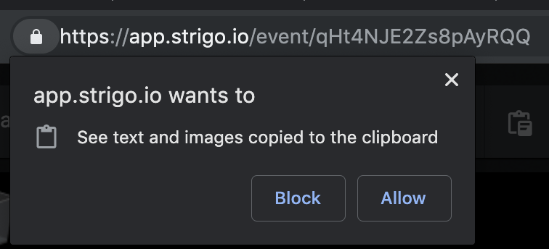
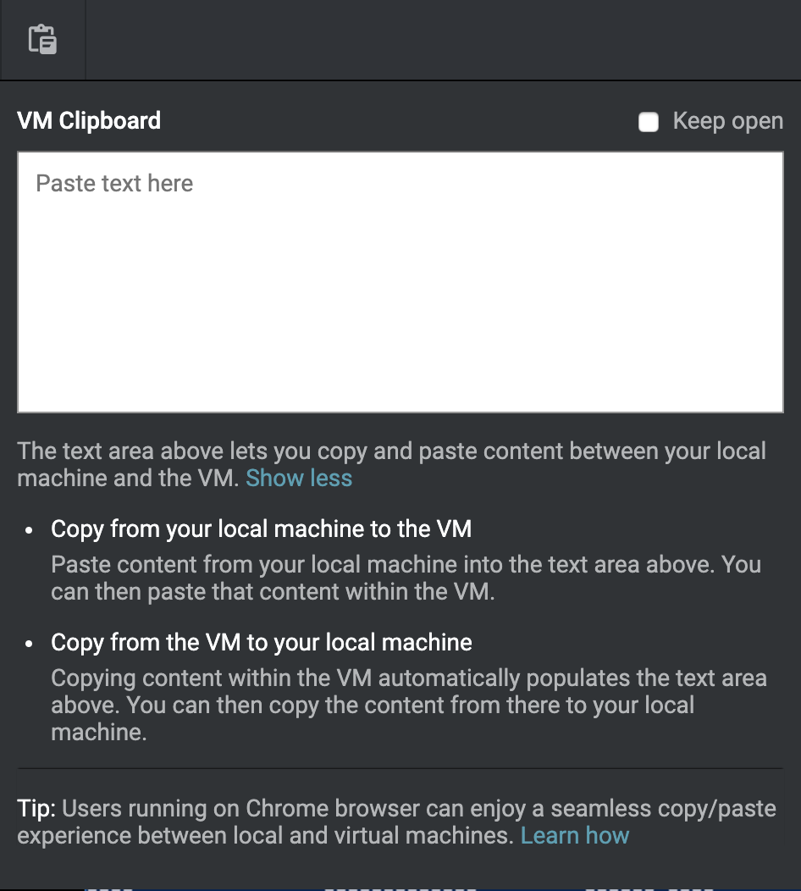
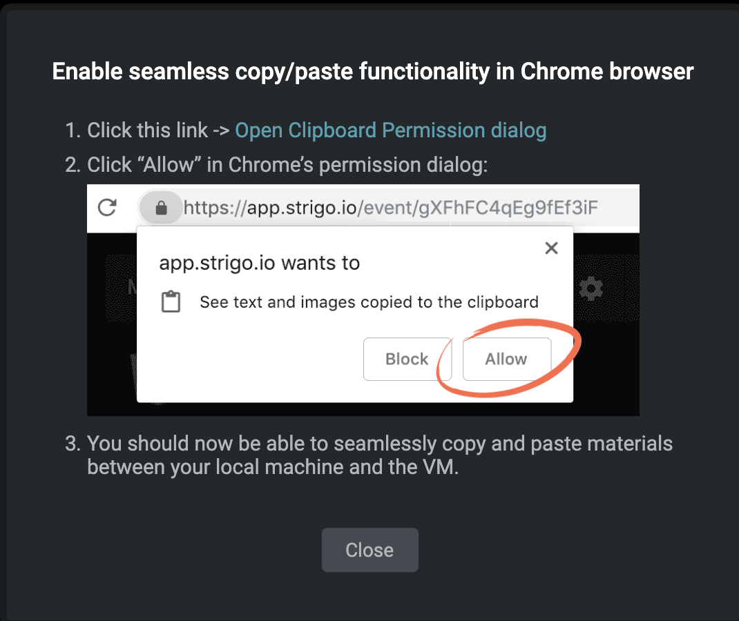
Windows Scripted Install
Seamless Clipboard Access using Google Chrome
1
Select the clipboard icon
2
Select Show more
5
4
Select Allow
Select ‘Open Clipboard…’
3
Select Learn how
Notes:
Questions:
Do any of you automate Windows endpoints today?
Hands for:
GPO, Custom tooling, Proprietary?
How you monitor and debug that automation?

Slide 9
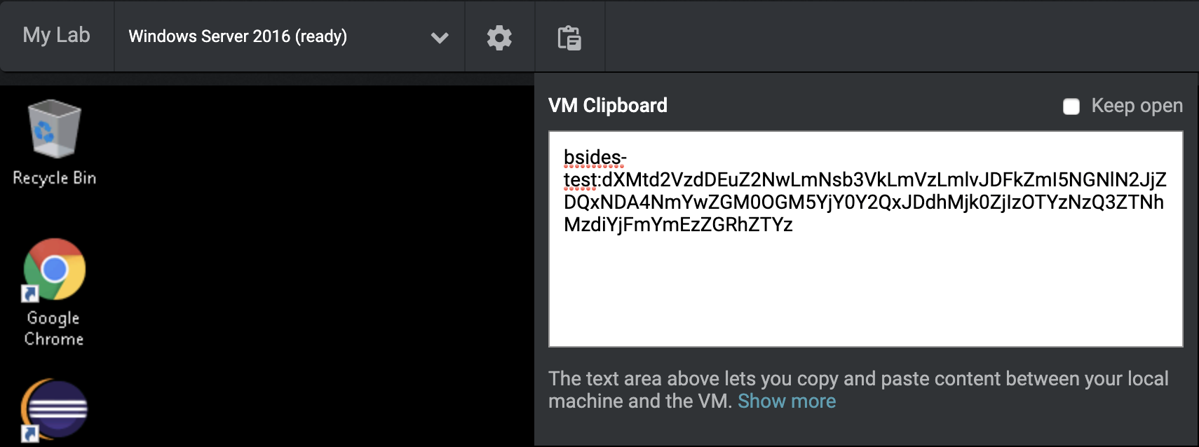
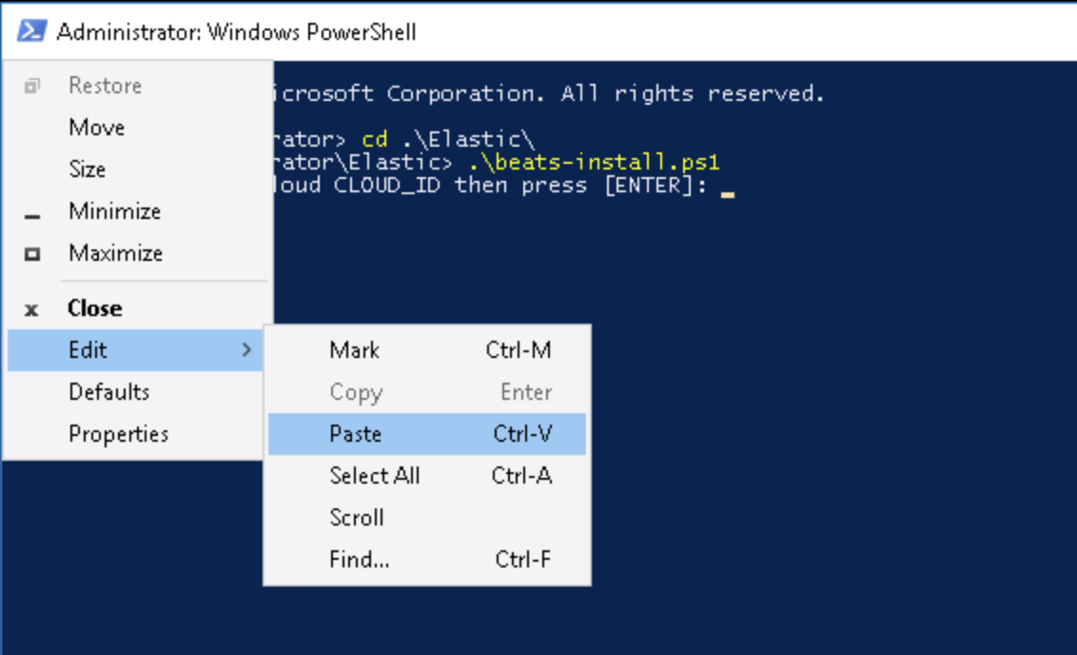
Windows Scripted Install
You must use the Strigo VM Clipboard to Copy Text to the Instance
4
Copy-n-Paste CLOUD ID and the elastic user’s password
1
Select the clipboard icon
2
Copy-n-Paste CLOUD ID
3
Type: bea <TAB to autocomplete .\beats-install.ps1>
<RETURN/ENTER>
Notes:
Questions:
Do any of you automate Windows endpoints today?
Hands for:
GPO, Custom tooling, Proprietary?
How you monitor and debug that automation?

Slide 10
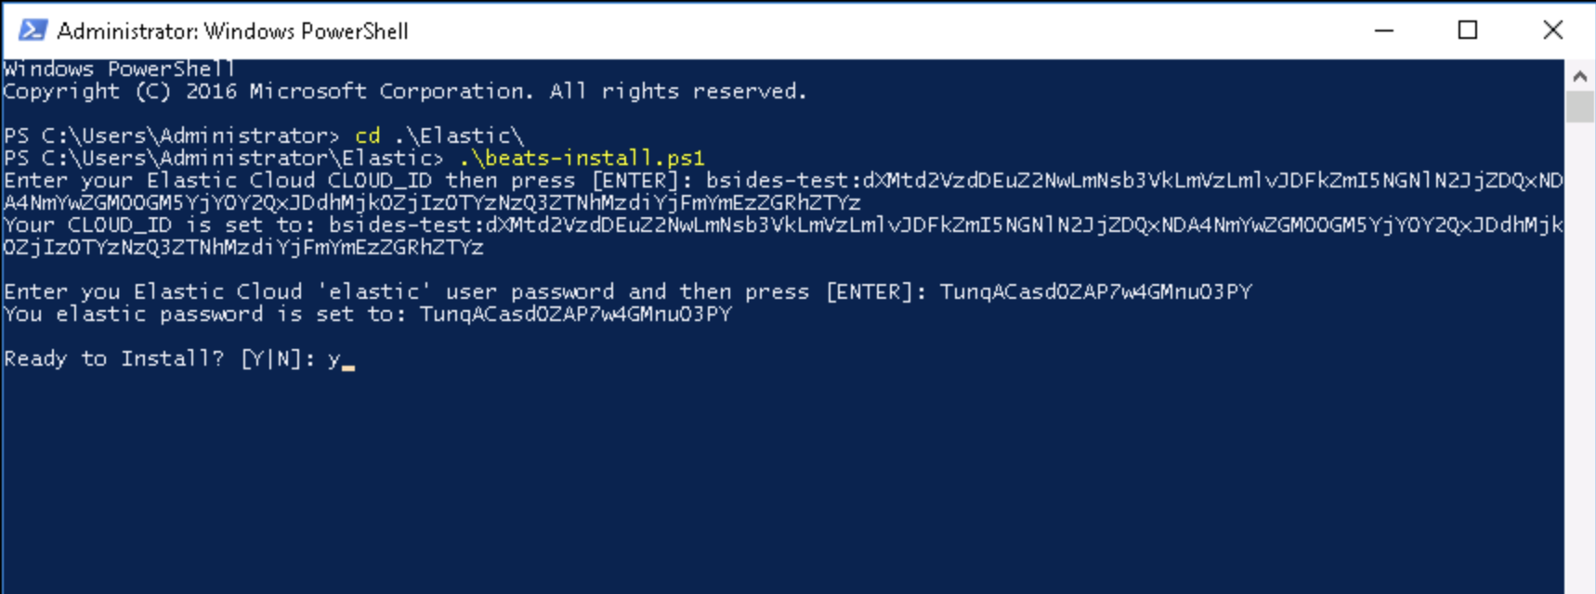
Windows Scripted Install
Winlogbeat & Metricbeat Installation

Slide 11
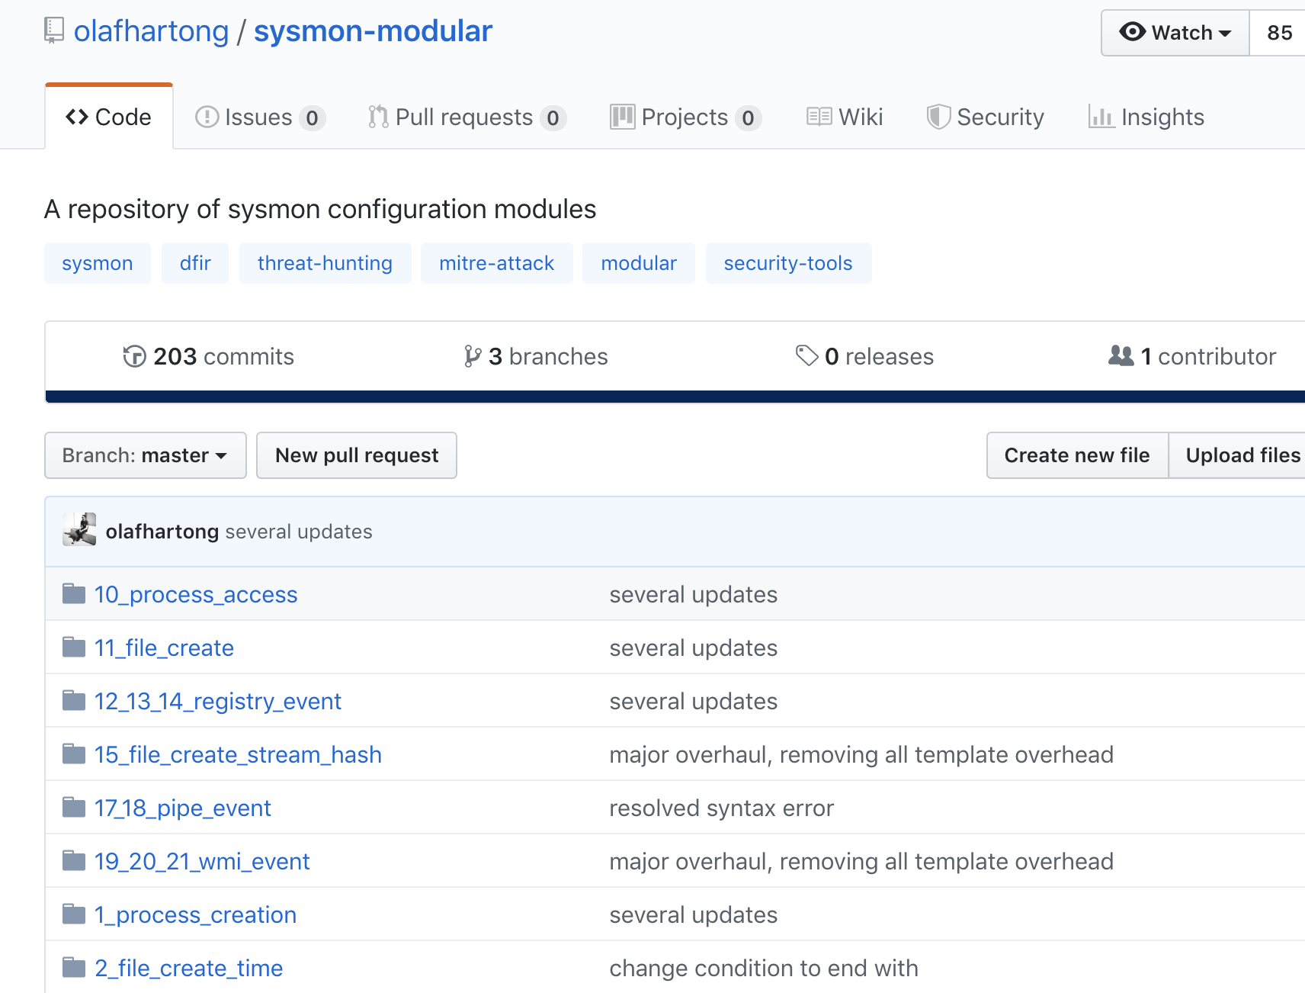
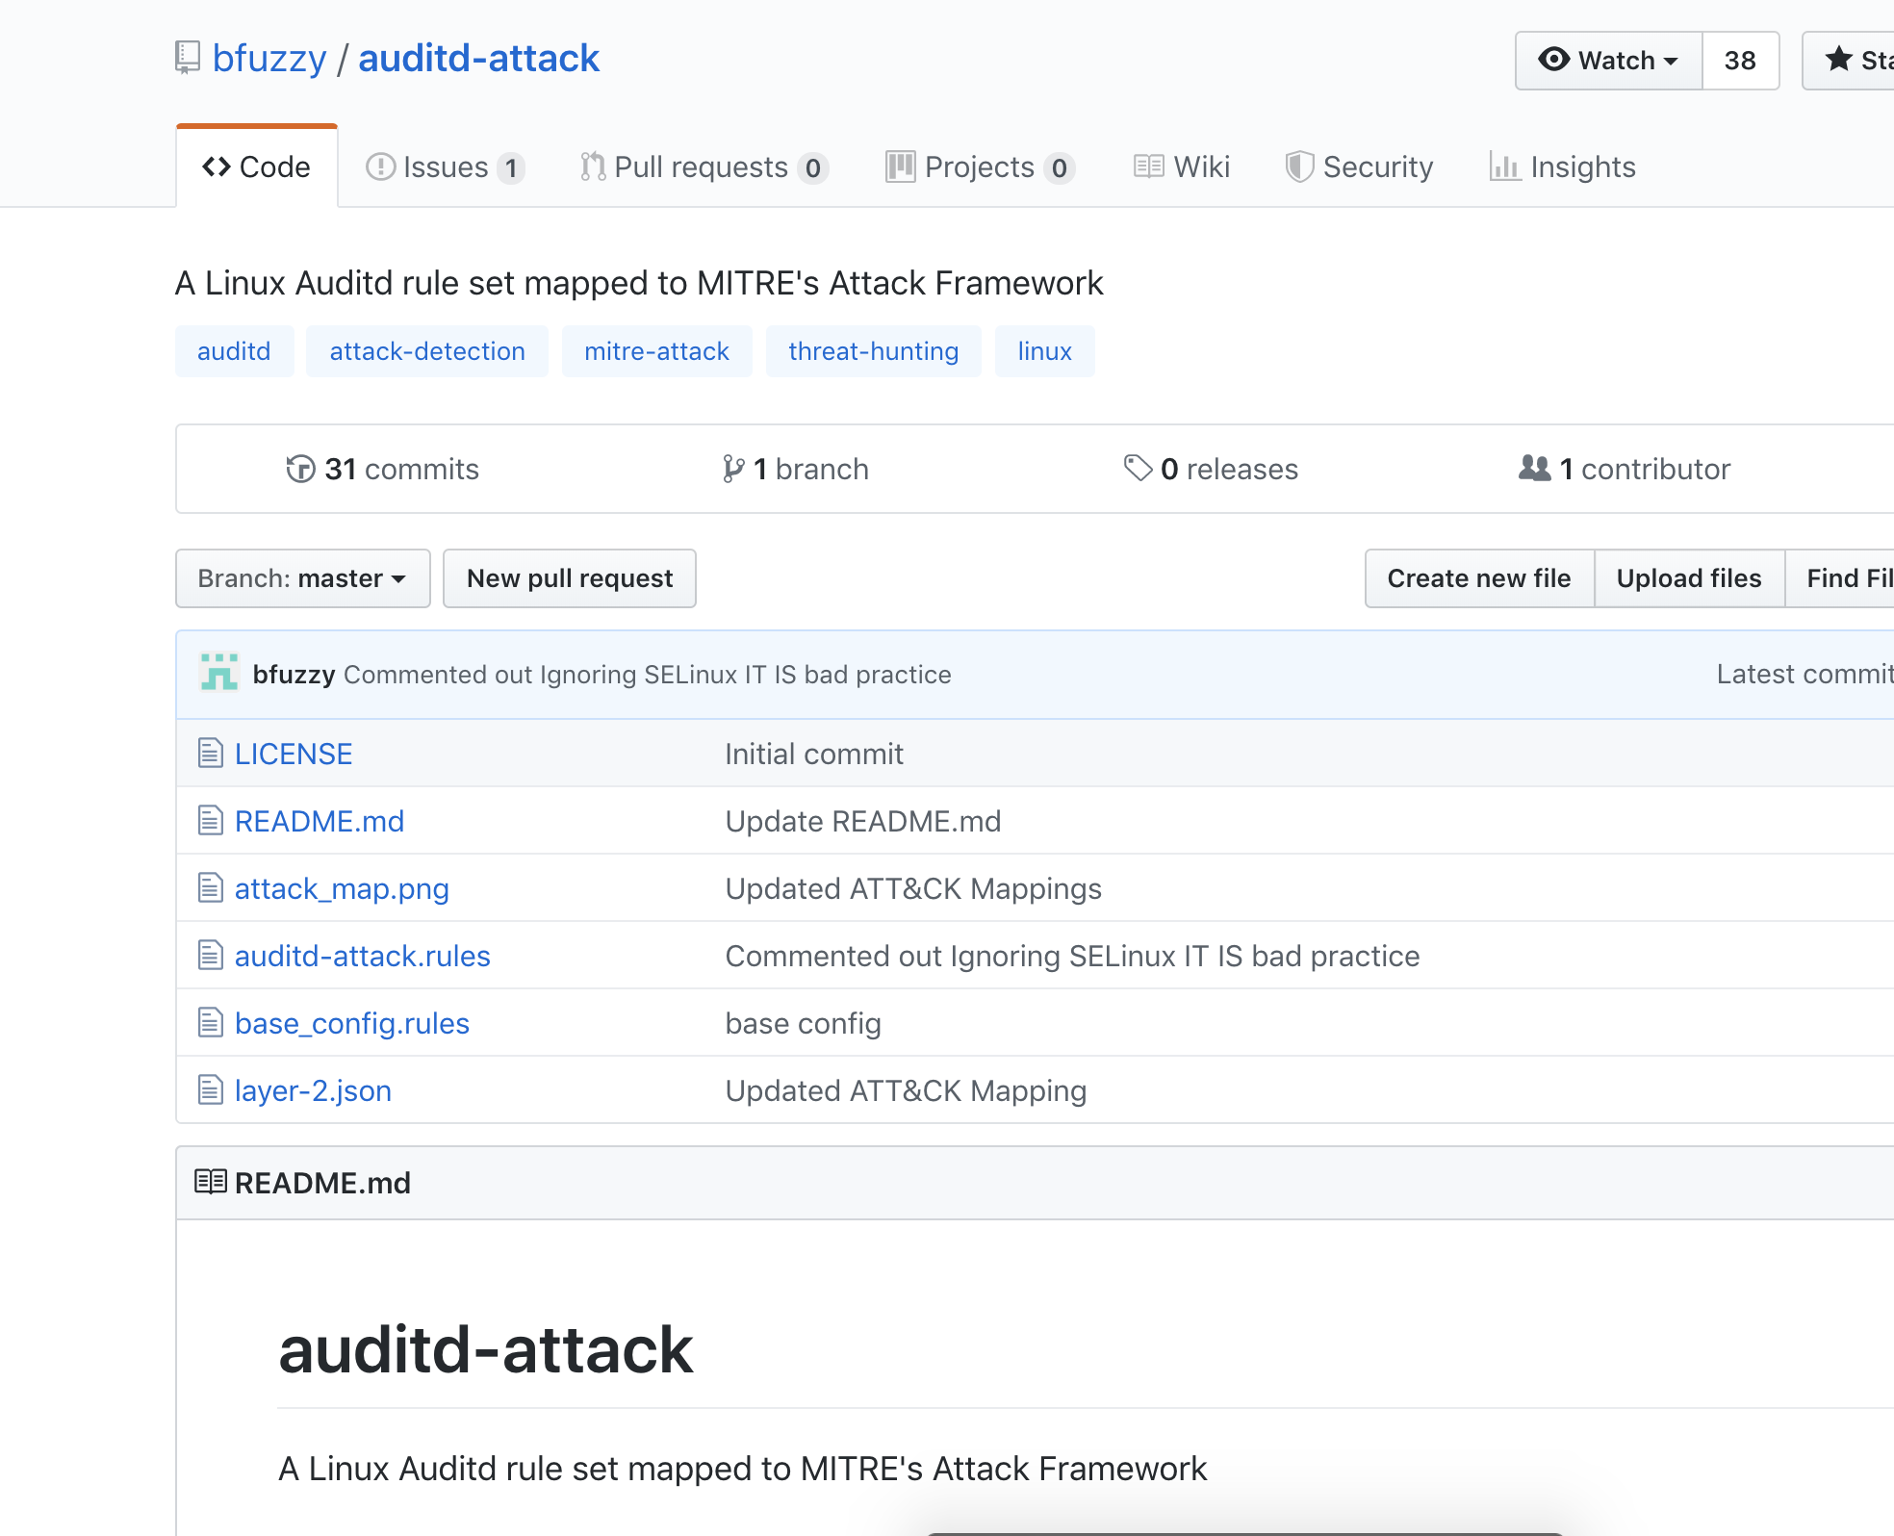
ATT&CK™ Beats Community
ATT&CK™ Configs Thanks to the Community
olafhartong / sysmon-modular
bfuzzy / auditd-attack

